Slide 1
The Particle in A Box

Slide 2
Particle in a box
Step 1: Define the potential energy
Step 2: Solve the Schrodinger equation
Step 3: Define the wave function
Step 4: Determine the allowed energies
Step 5: Interpret its meaning

Slide 3
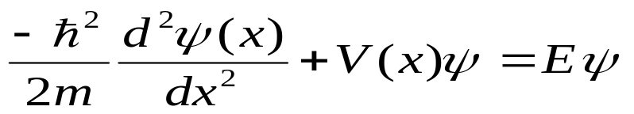
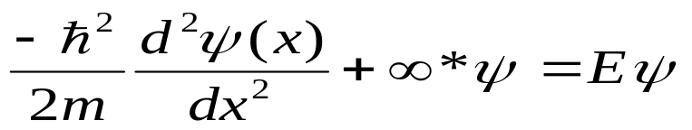

Particle in 1-dimensional box
Infinite walls
Time Independent Schrödinger Equation
Region I
Region II
Region III
KE
PE
TE
Applying boundary conditions:
V(x)=∞
V(x)=0
V(x)=∞
Region I and III:
0
L
x

Slide 4
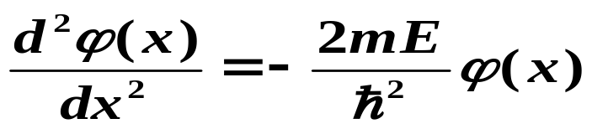
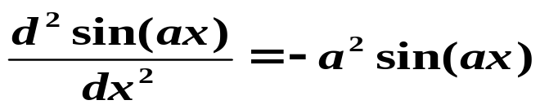
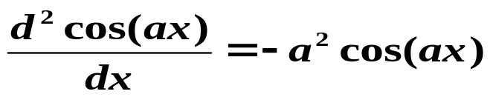
Second derivative of a function equals a
negative constant times the same function.
Functions with this property sin and cos.
Copyright – Michael D. Fayer, 2007

Slide 5

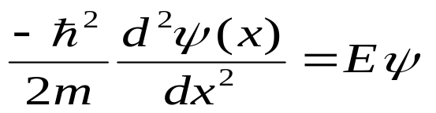


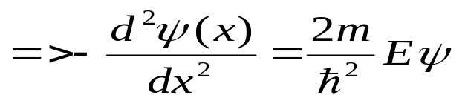
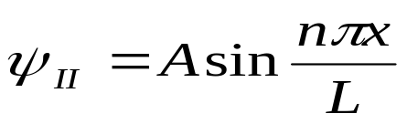
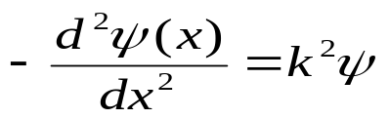

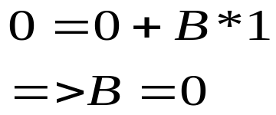
b) x=L ψ=0
Region II:
Thus, wave function:
This is similar to the general differential equation:
But what is ‘A’?
Applying boundary conditions:
a) x=0 ψ=0

Slide 6
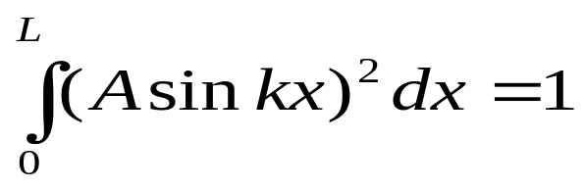
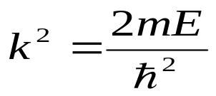
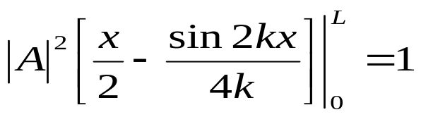
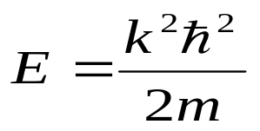
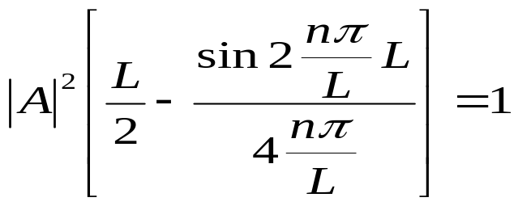
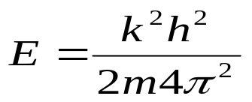
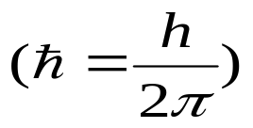
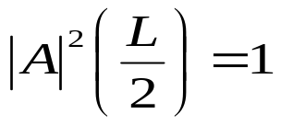
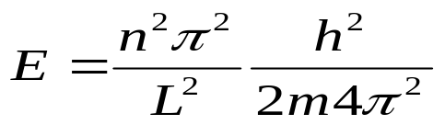
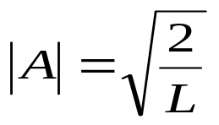
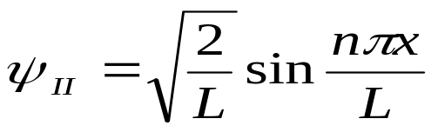
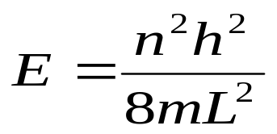
Normalizing wave function:
Calculating Energy Levels:
Thus normalized wave function is:
Thus Energy is:

Slide 7
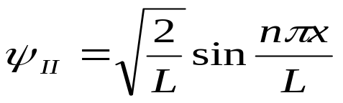
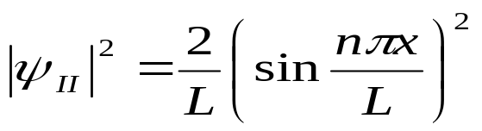
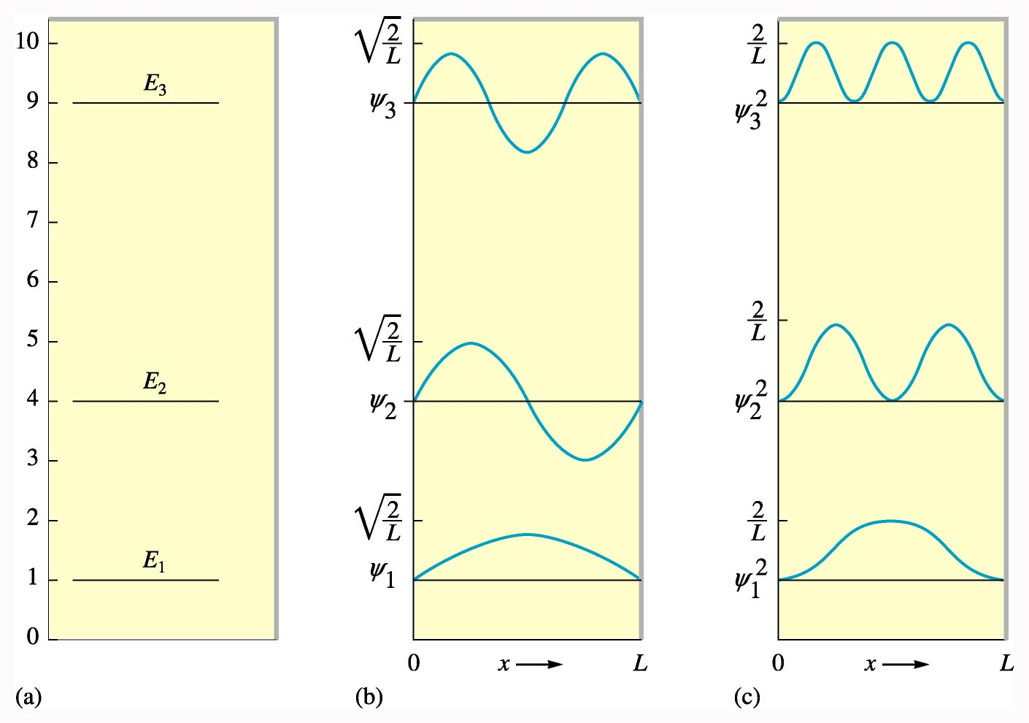

Particle in a 1-Dimensional Box
Difference b/w adjacent
energy levels:
2) Non-zero zero point energy
3) Probability density is structured
with regions of space demon-
-strating enhanced probability.
At very high n values, spectrum
becomes continous-
convergence with CM
(Bohr’s correspondance
principle)
+
+
+
-
+
+
E
ψ
ψ∗ψ

Slide 8
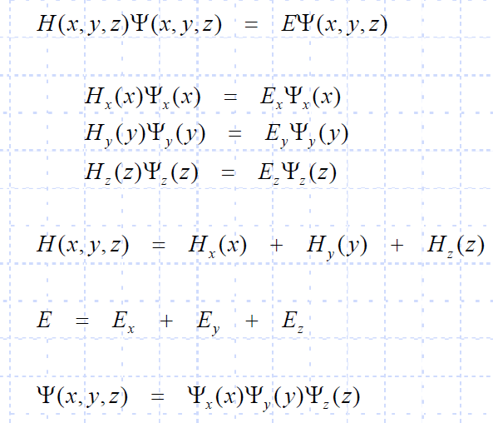
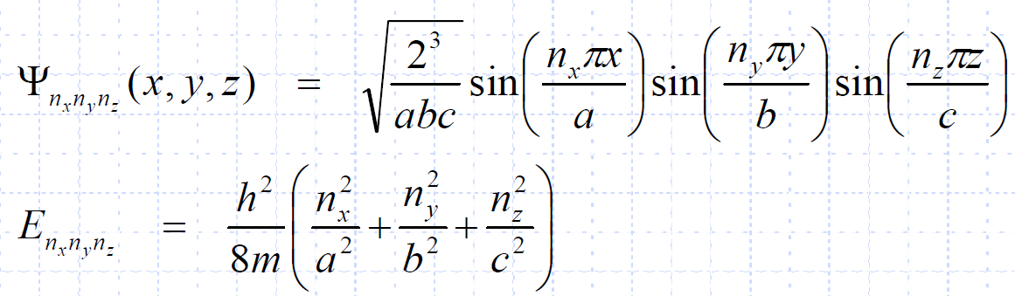
Particle in a 3-D box

Slide 9
Question: An electron is in 1D box of 1nm length. What is the probability of locating the electron between x=0 and x=0.2nm in its lowest energy state?

Slide 10

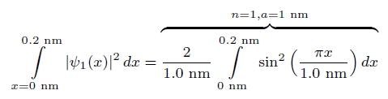


Question: An electron is in 1D box of 1nm length. What is the probability of locating the electron between x=0 and x=0.2nm in its lowest energy state?
Solution:

Slide 11
Question: What are the most likely locations of a particle in a box of length L in the state n=3

Slide 12
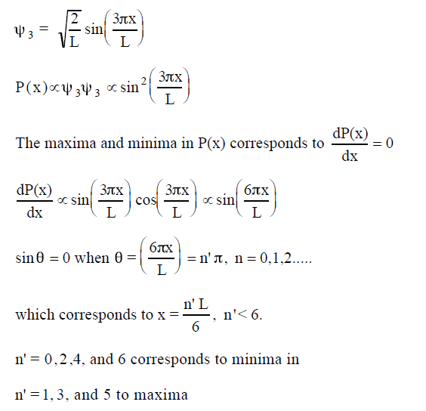
Example: What are the most likely locations of a particle in a box of length L in the state n=3

Slide 13
Expectation value of position and its uncertainty

Slide 14







Expectation values
Position
Uncertainity

Slide 15
Expectation value of Momentum
And square of momentum

Slide 16

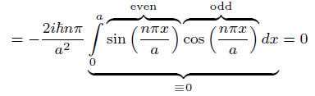


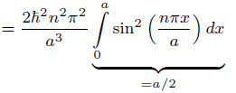

Momentum

Slide 17
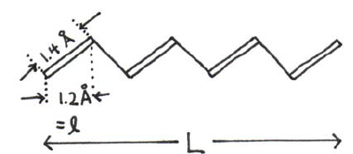
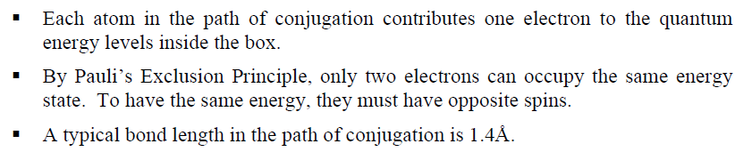
Estimating pigment length
Assumptions:

Slide 18
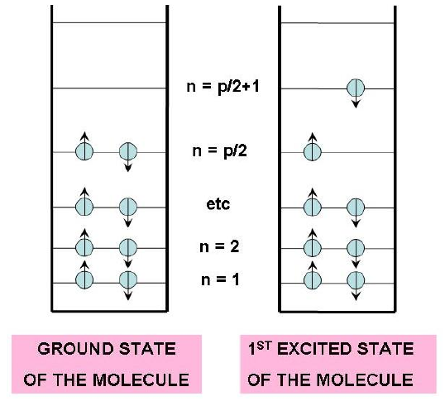


Slide 19
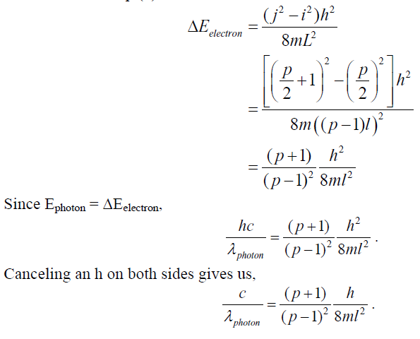

Slide 20
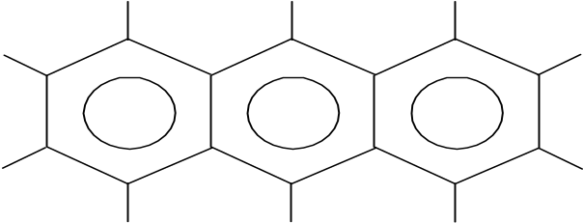
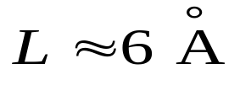
Wavelength of transition for Anthracene
Particle in a Box Simple model of molecular energy levels.
Anthracene
π electrons – consider “free”
in box of length L.
Ignore all coulomb interactions.
L

Slide 21
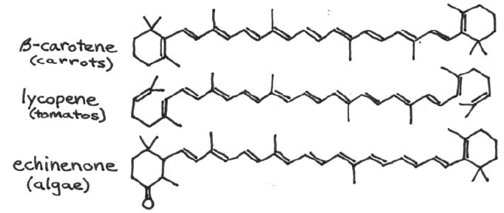
Pigments and Quantum mechanics
High degree of conjugation!!
Electrons have wave properties and they don’t jump off the pigments when they reach its ends.
These electrons resonances determine which frequencies of light and thus which colors, are absorbed & emitted from pigments

Slide 22
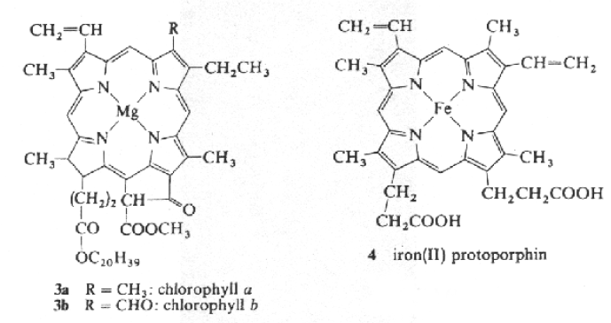

Electron resonances in a cyclic conjugated molecule
A crude quantum model for such molecules assumes that electrons move freely in a ring.
Resonance condition:
R: radius of molecule, λ wavelength of electron

Slide 23


Energy is once again quantized. It depends on variable n which posseses discrete values only

